Slide 1
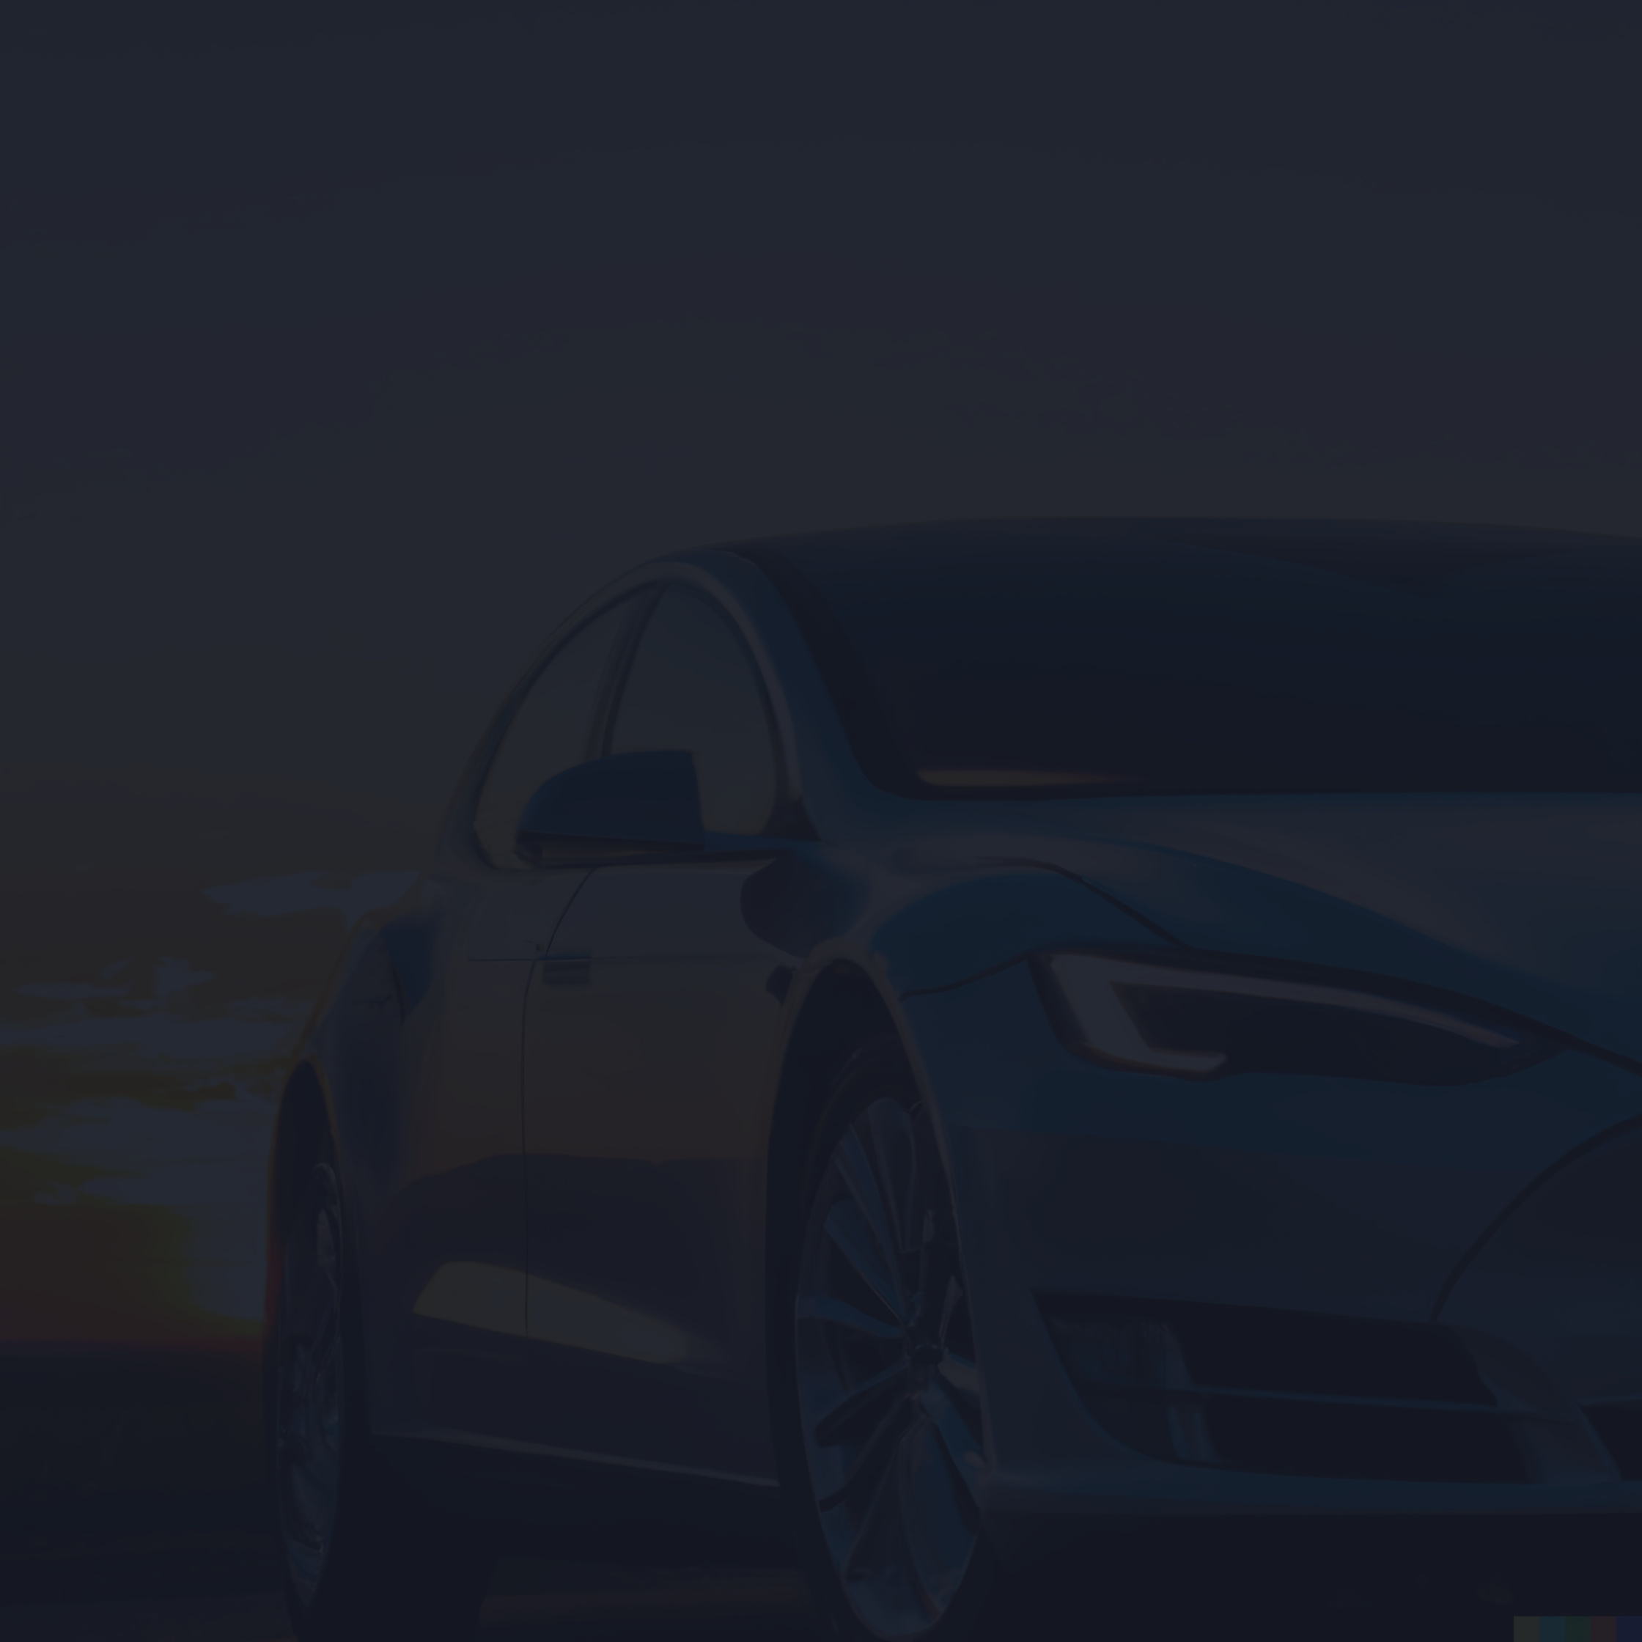

SUZUKI
Home
Service
About Us
Contact
WAY OF LIFE
PAK SUZUKI MOTORS
ANALYSIS AND INSIGHTS
Ssyeda Dua Atiq
23sp-010-ba
Hiba Tanveer Khan
23sp-004-ba

Slide 2
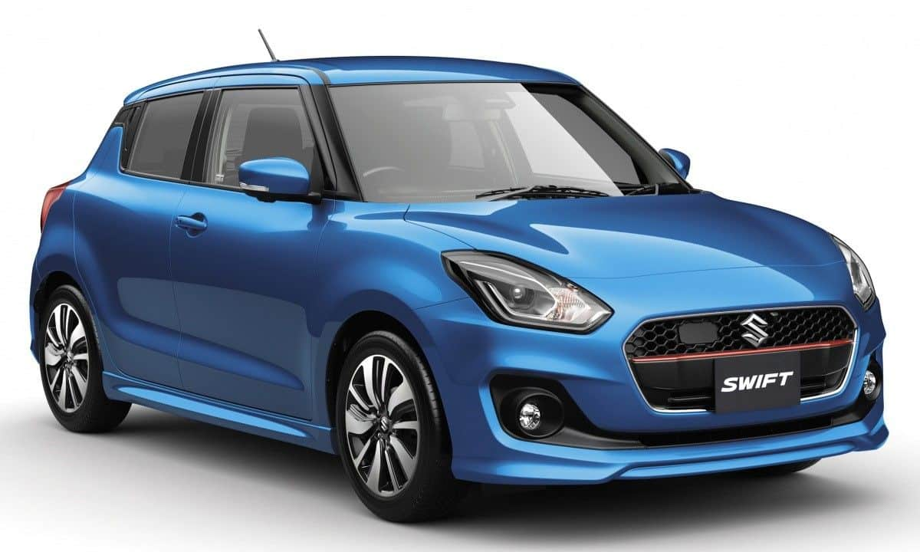
SUZUKI
Home
Service
About Us
Contact
ABOUT US
Pak Suzuki Motor Company Limited, commonly known as Pak Suzuki, is a subsidiary of Suzuki Motor Corporation Japan. Established in 1983, Pak Suzuki has grown to be a leading automobile manufacturer in Pakistan, market leader with 50% share .The company offers a wide range of vehicles, including cars, motorcycles, and outboard motors, catering to diverse consumer needs.
Location
Pak suzuki motors company located at ;
DSU-13, Pakistan Steel Industrial Estate Bin Qasim Town, Karachi

Slide 3
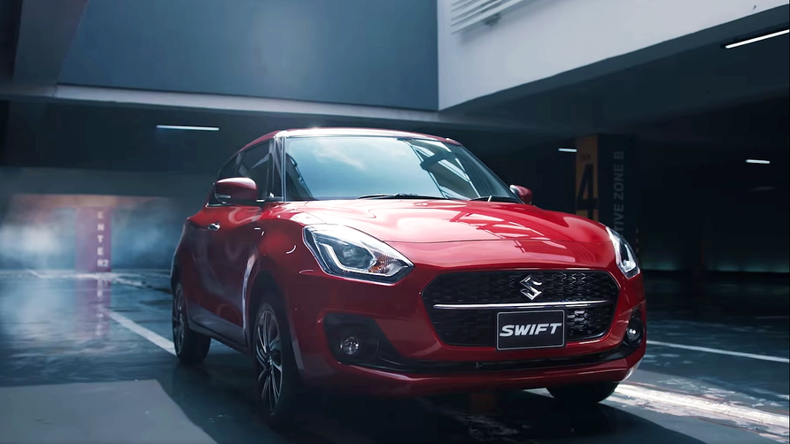
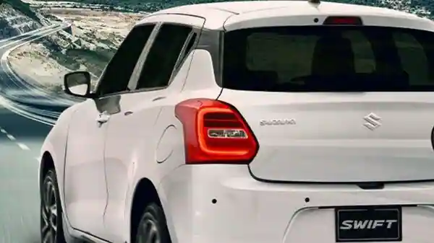
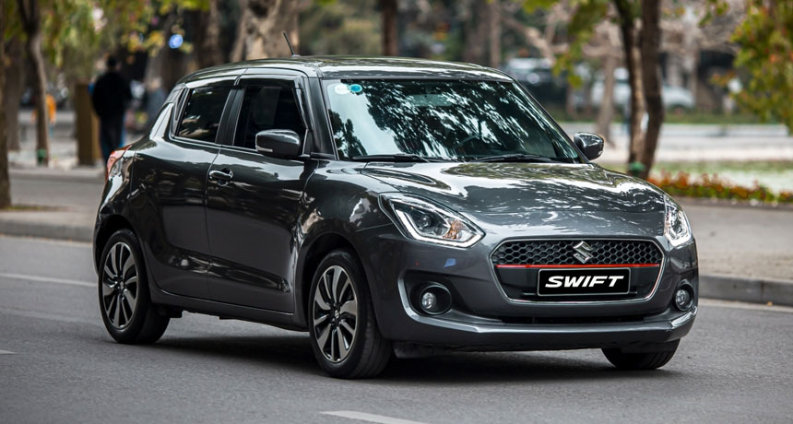
SUZUKI
Home
Service
About Us
Contact
VISION
To be recognized as a leading organization that values Customers’ needs and provides motoring solutions with strong customer care.
MISSION
Develop products of superior value by focusing on the customer
Establish a refreshing and innovative company through teamwork
Strive for individual excellence through continuous improvement

Slide 4
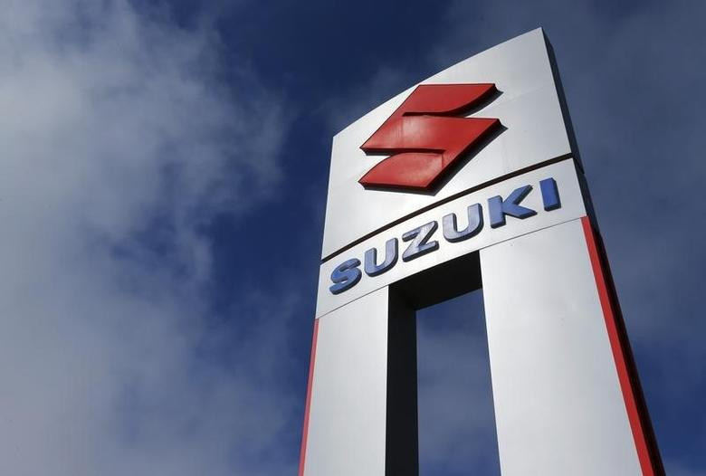
SUZUKI
Home
Service
About Us
Contact
BRAND TRAITS
Reliable vehicles.
Affordable solutions.
Innovative technology.
Customer-centric approach.

Slide 5

Marketing Philosophy
Customer-centric approach
Focus on quality and value

Slide 6
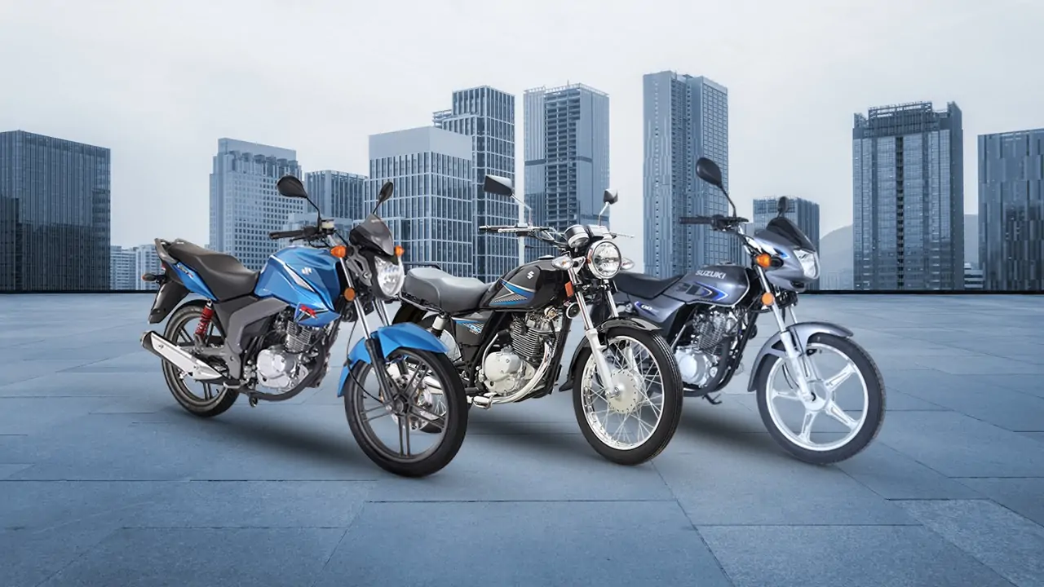
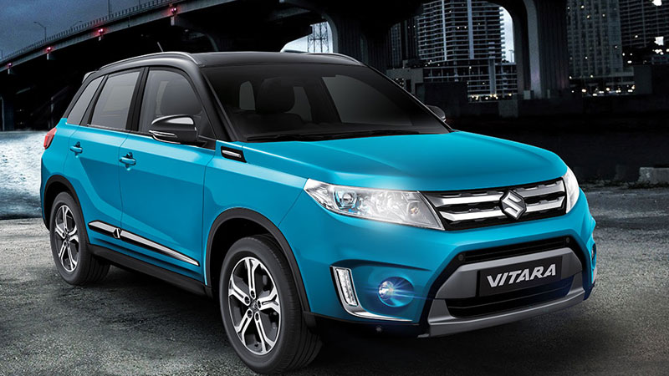
SUZUKI
Home
Service
About Us
Contact
PRODUCT INDUSTRY
Main Products
Automobiles: Cars and motorcycles
Associated Services: Maintenance and spare parts

Slide 7
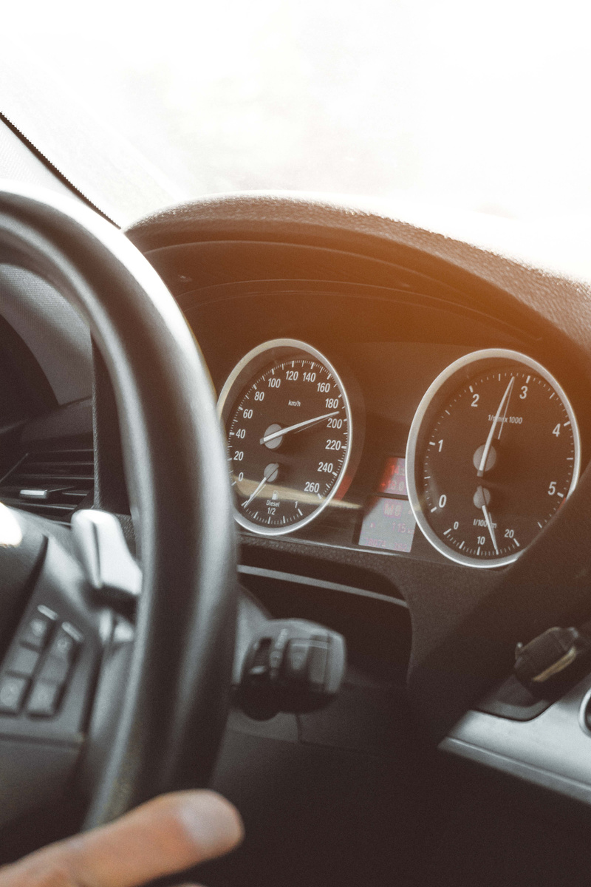
SUZUKI
Home
Service
About Us
Contact
TARGET MARKET
PRODUCT SOURCING
B2C (individual consumers)
B2B (corporate clients, government contracts, services)
Pak Suzuki Motors sources its products by manufacturing in-house at its own facilities in Pakistan.
SEGMENTATION
Demographics: Age, income, family size
Psychographics: Lifestyle, preferences
Behavior: Purchase patterns

Slide 8
SUZUKI
Home
Service
About Us
Contact
PRODUCT SOURCING
Pak Suzuki Motors sources its products by manufacturing in-house at its own facilities in Pakistan.
MARKETING MANAGEMENT ORIENTATION
Production Concept: Focus on efficient, large-scale manufacturing to keep costs low and meet high demand.
Selling Concept: Use of aggressive sales tactics, extensive dealership networks, and regular promotions to drive vehicle sales.

Slide 9



RELATIVE MARKET SHARE
High Low
Suzuki Swift 1200cc
Suzuki Inazuma 250
BCG MARTIX OF
PAK SUZUKI MOTORS
MARKET GROWTH RATE
Low High
Cultus
Alto
mehran
Suzuki Liana
WagonR

Slide 10

Micro & Macro Environments
Microenvironment
Customers: Pak Suzuki designs and markets vehicles like the Suzuki Mehran and Suzuki Swift tailored to meet the needs and preferences of Pakistani consumers, ensuring competitive pricing and features..
Macroenvironment
Technological Trends: Embracing advancements in automotive technology, Pak Suzuki integrates fuel-efficient engines and advanced safety features into its vehicles to meet regulatory requirements and consumer demands in Pakistan.

Slide 11
Competitor Analysis for Pak Suzuki Motors
Direct competitor
Indirect competitor
Toyota:
High-quality, reliable vehicles.
Nissan:
Offers SUVs, advanced technology
Honda:
Innovative technology, high resale value
Hyundai:
Stylish designs, comprehensive warranty
Changan:
Affordable vehicles, expanding dealerships
Kia Motors:
Feature-rich vehicles, competitive prices

Slide 12
Key Advantages of Pak Suzuki Motors
Pak Suzuki offers competitive pricing relative to its features and quality compared to direct competitors like Toyota and Honda.
Competitive Pricing
Brand Loyalty
Having built a strong brand presence and trust over the years, Pak Suzuki enjoys significant customer loyalty in the Pakistani market.
With an extensive dealership and service network across Pakistan, Pak Suzuki ensures accessible support and maintenance for its vehicles.
Strong Network
Understanding local market preferences and needs, Pak Suzuki tailors its models to better suit Pakistani consumers.
Localized Expertise

Slide 13
S
W
O
T
STRENGTHS | WEAKNESSES | OPPORTUNITIES | THREATS
Brand reputation. Extensive network. 168+ Dealership all over Pakistan Wide Geographic Presence Product Reliability and Service Accessibility | Limited presence in high-end vehicle segment. Dependence on imported components. | Growing demand for fuel-efficient vehicles. Expansion into electric vehicles market. | Intense competition from international brands. Economic instability affecting consumer purchasing power.

Slide 14
Marketing Mix
Promotion
Product
Pricing
Flexible Marketing Budget
Social Media Presence
interactive campaigns’ Discounts on service packages.
Exclusive offers to drive brand affinity
Attributes: High quality, fuel efficiency, modern design.
Branding: Strong brand identity and customer loyalty.
Packaging: Attractive and functional vehicle design.
Product Line: Diverse range of cars and motorcycles.
Strategy: Competitive pricing to attract middle-class consumers.
Price Adjustments: Responding to market changes and inflation rates.
Place
Distribution Channels: Extensive network of dealerships and service centers.
Sales Strategy: Retail sales through showrooms and online platforms.

Slide 15
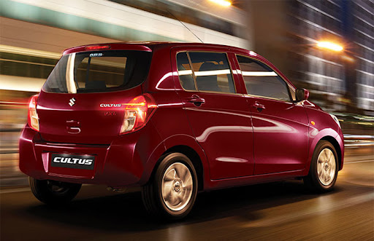
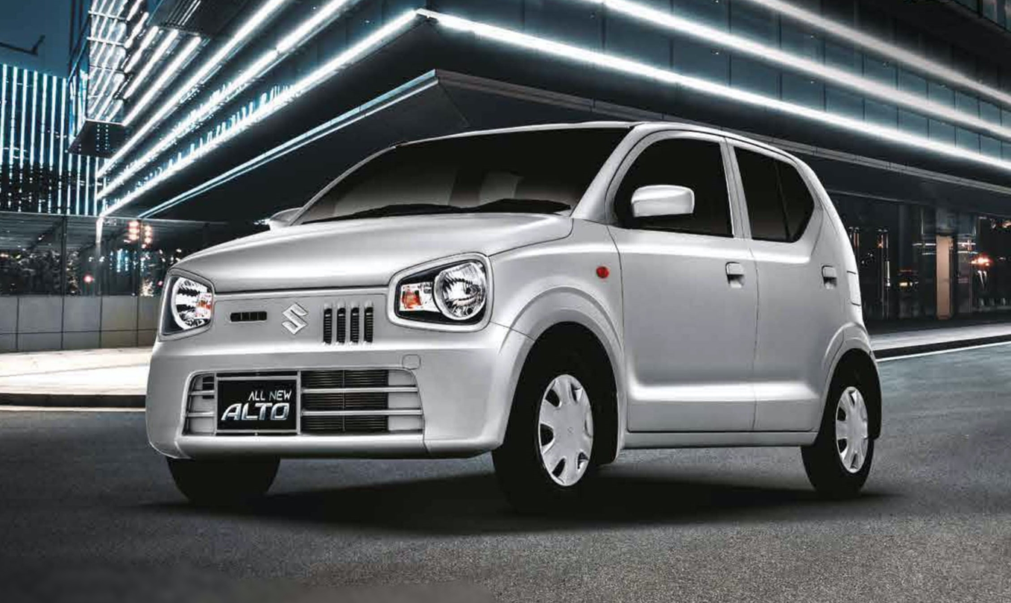
SUZUKI
Home
Service
About Us
Contact
CONCLUSION
Pak Suzuki is strategically positioned to navigate the complexities of the Pakistani automotive market with plans to expand its product offerings nationwide and optimize distribution channels. While challenges persist, particularly in aligning regional consumer preferences, the company recognizes opportunities in introducing innovative sales initiatives like used car programs and exchange offers. By leveraging its strong brand presence and adaptive marketing strategies, Pak Suzuki aims to sustain growth and enhance customer satisfaction in the evolving automotive landscape of Pakistan.

Slide 16
